Slide 1

Spatio-Temporal Urban Sentiment Analysis
Author: Rana Emad
Supervisor: Assoc. Prof. Mervat Abuelkheir
Spatio-Temporal Urban Sentiment Analysis

Slide 2
Outline
Introduction
Background
Methodology
Experiments and Analysis
Conclusion
Future Work
Spatio-Temporal Urban Sentiment Analysis
Notes:
Call the switches 1, 2 and 3. Leave Switch 1 off. Turn Switch 2 on for five minutes and then turn it off. Turn Switch 3 on and leave it on. Enter the room. The bulb that is on is controlled by Switch 3 (the one you left on). Feel the light bulbs that are off for heat. The bulb that is off and warm is controlled by Switch 2 (the one you turned on, then off). The bulb that is off and cold is controlled by Switch 1 (the one that you didn't turn on).

Slide 3
Introduction
Sentiment Analysis
Spatio-Temporal Sentiment Analysis
Research Problem: Spatio-Temporal Sentiment Analysis on Urban Neighborhoods
Spatio-Temporal Urban Sentiment Analysis

Slide 4
Background
Most used models:
LSTM
Logistic Regression
Naive Bayes
SVM
A systematic spatial and temporal sentiment analysis on Geo-Tweets:
VADER
Compass: Spatio temporal sentiment analysis of US election what twitter says:
Word2Vec
LSTM
SentiHood: Targeted aspect based sentiment analysis dataset for urban neighborhoods.
LR
LSTM
Spatio-Temporal Urban Sentiment Analysis

Slide 5
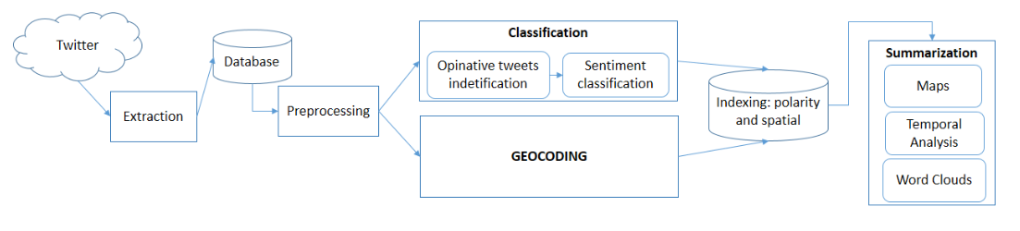
Methodology
Spatio-Temporal Urban Sentiment Analysis

Slide 6

Datasets and Data Collection
SentiHood
Annotated
Imbalanced
Twitter Corpus collected using Twitter scrapping tool: TWINT
Geotags Approach
Keyword Search Approach
Spatio-Temporal Urban Sentiment Analysis

Slide 7
Data Pre-processing
Filtering tweets by language
Removing duplicates and data of no value
Handling abbreviations and punctuations
Lemmatization
Spatio-Temporal Urban Sentiment Analysis

Slide 8

Target Extraction
Named Entity Recognition (NER) was used to extract the targeted location.
Spatio-Temporal Urban Sentiment Analysis

Slide 9
Sentiment Classification
Binary class classification
Data Vectorization:
CountVectorizer
Word2Vec
Sentihood classifiers:
Logistic Regression (LR)
Stochastic Gradient Descent (SGD)
Twitter Corpus classifiers:
VADER
TextBlob
Spatio-Temporal Urban Sentiment Analysis

Slide 10
Experiments and Analysis
Datasets and Data Collection:
SentiHood:
Over-sampling Sentihood dataset improved the accuracy of the classifiers by 6%.
Twitter Corpus:
Filtering English language and disregarding redundant tweets reduced the size of the corpus from 76,000 to 39,000 tagging 18 cities.
Only 1100 from 39,000 were collected using Geo-tagging (2.8%), tagging only 1 city.
Spatio-Temporal Urban Sentiment Analysis
Optimizing and Recycling of PET and PE blends for Additive Manufacturing Applications using different mixing ratios

Slide 11
Experiments and Analysis
Target Extraction:
SpaCy library was used for NER.
We filter only the location tags (GPE) to extract cities and countries names only.
After training the model on our data, the accuracy of the model reached 93%.
SentiHood: 47 boroughs/towns were tagged.
Spatio-Temporal Urban Sentiment Analysis
Optimizing and Recycling of PET and PE blends for Additive Manufacturing Applications using different mixing ratios

Slide 12



Experiments and Analysis
Sentiment Classification:
The analysis for the sentiment consists of 3 parts for both datasets:
Sentiment classifiers performances
Temporal Sentiment Analysis
Spatial Sentiment Analysis
Spatio-Temporal Urban Sentiment Analysis
Optimizing and Recycling of PET and PE blends for Additive Manufacturing Applications using different mixing ratios

Slide 13
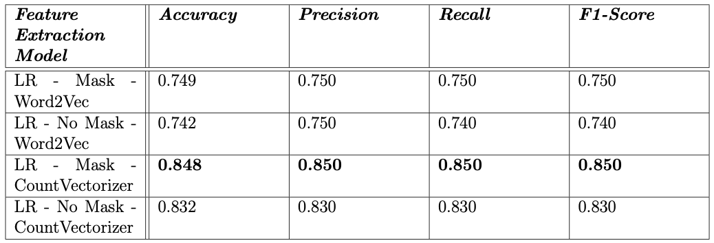
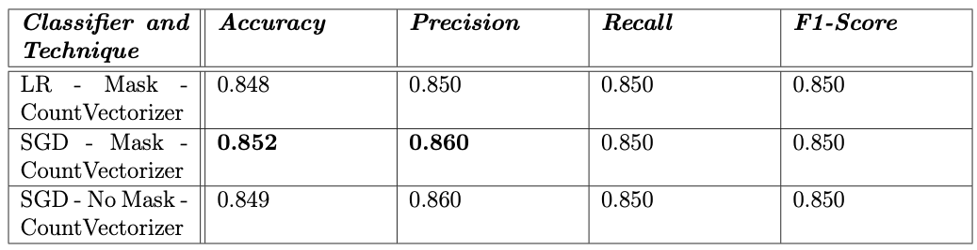
Sentiment Classification Results: SentiHood
The highest accuracy (85.2%) was reached when applying CountVectorizer, Location Masking and Stochastic Gradient Descent model.
Spatio-Temporal Urban Sentiment Analysis
Optimizing and Recycling of PET and PE blends for Additive Manufacturing Applications using different mixing ratios

Slide 14
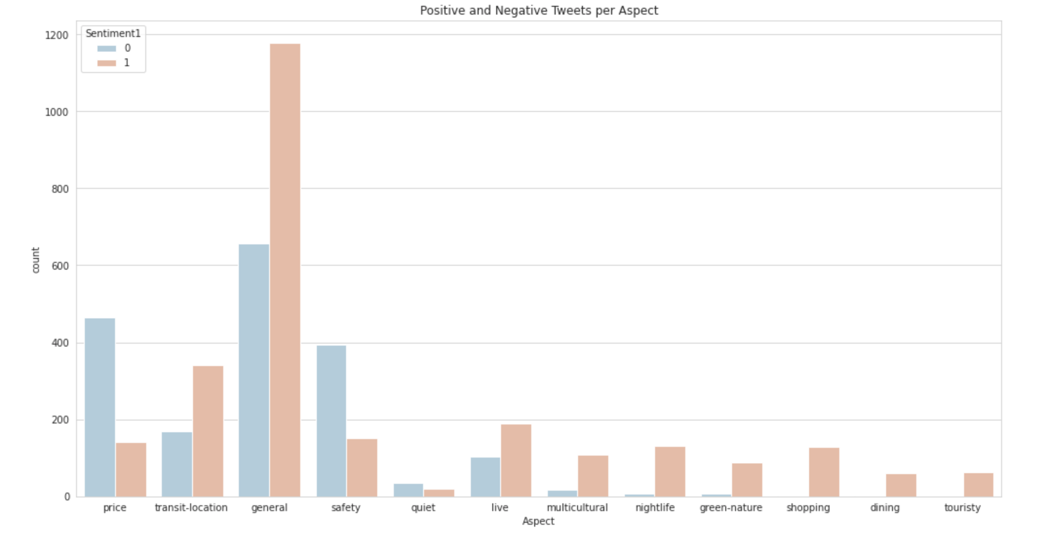
Sentiment Classification Results: SentiHood
Most users express their opinion of a borough directly without mentioning an aspect
Price, followed by safety, were mostly associated with negative sentiment
Transit-location and livability were associated with positive sentiment
Spatio-Temporal Urban Sentiment Analysis
Optimizing and Recycling of PET and PE blends for Additive Manufacturing Applications using different mixing ratios

Slide 15
Sentiment Classification Results: SentiHood
England is notorious for high-priced living conditions.
This dataset was collected in 2016, during the Brexit and a subsequent political fallout.
Therefore, price and safety association with negative sentiment agrees with hypothesis.
England is well known for high living standards and high quality services provided by the government.
Therefore, transit-location and livability association with positive sentiment was expected.
Spatio-Temporal Urban Sentiment Analysis
Optimizing and Recycling of PET and PE blends for Additive Manufacturing Applications using different mixing ratios

Slide 16
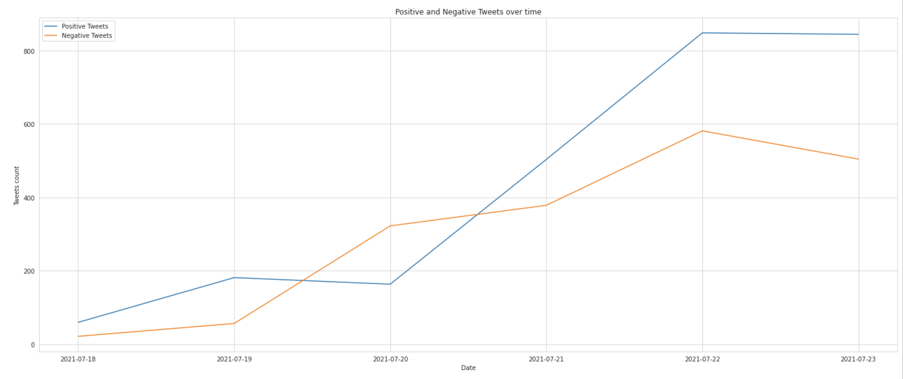
Sentiment Classification Results: SentiHood
Temporal analysis for SentiHood was simulated using time frame captured from twitter corpus.
The overall sentiment of all boroughs over time was positive
Spatio-Temporal Urban Sentiment Analysis
Optimizing and Recycling of PET and PE blends for Additive Manufacturing Applications using different mixing ratios

Slide 17
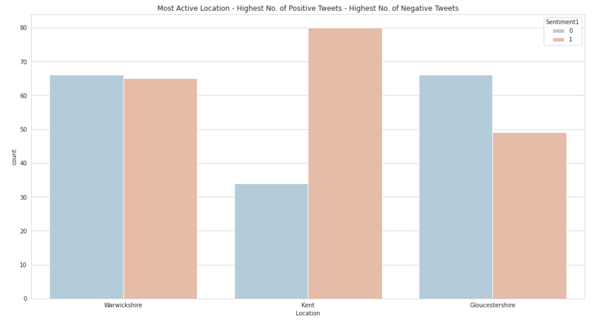
Sentiment Classification Results: SentiHood
Analyzing the top 3 active places:
Warwickshire was the most active
Kent was the most positive
Gloucestershire was the most negative
Spatio-Temporal Urban Sentiment Analysis
Optimizing and Recycling of PET and PE blends for Additive Manufacturing Applications using different mixing ratios

Slide 18
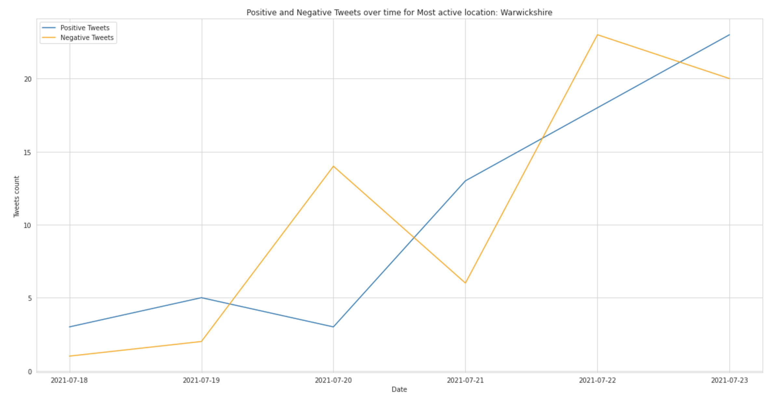
Sentiment Classification Results: SentiHood
Warwichshire
Most active town
Positive and negative tweets count almost equivalent
Spatio-Temporal Urban Sentiment Analysis
Optimizing and Recycling of PET and PE blends for Additive Manufacturing Applications using different mixing ratios

Slide 19
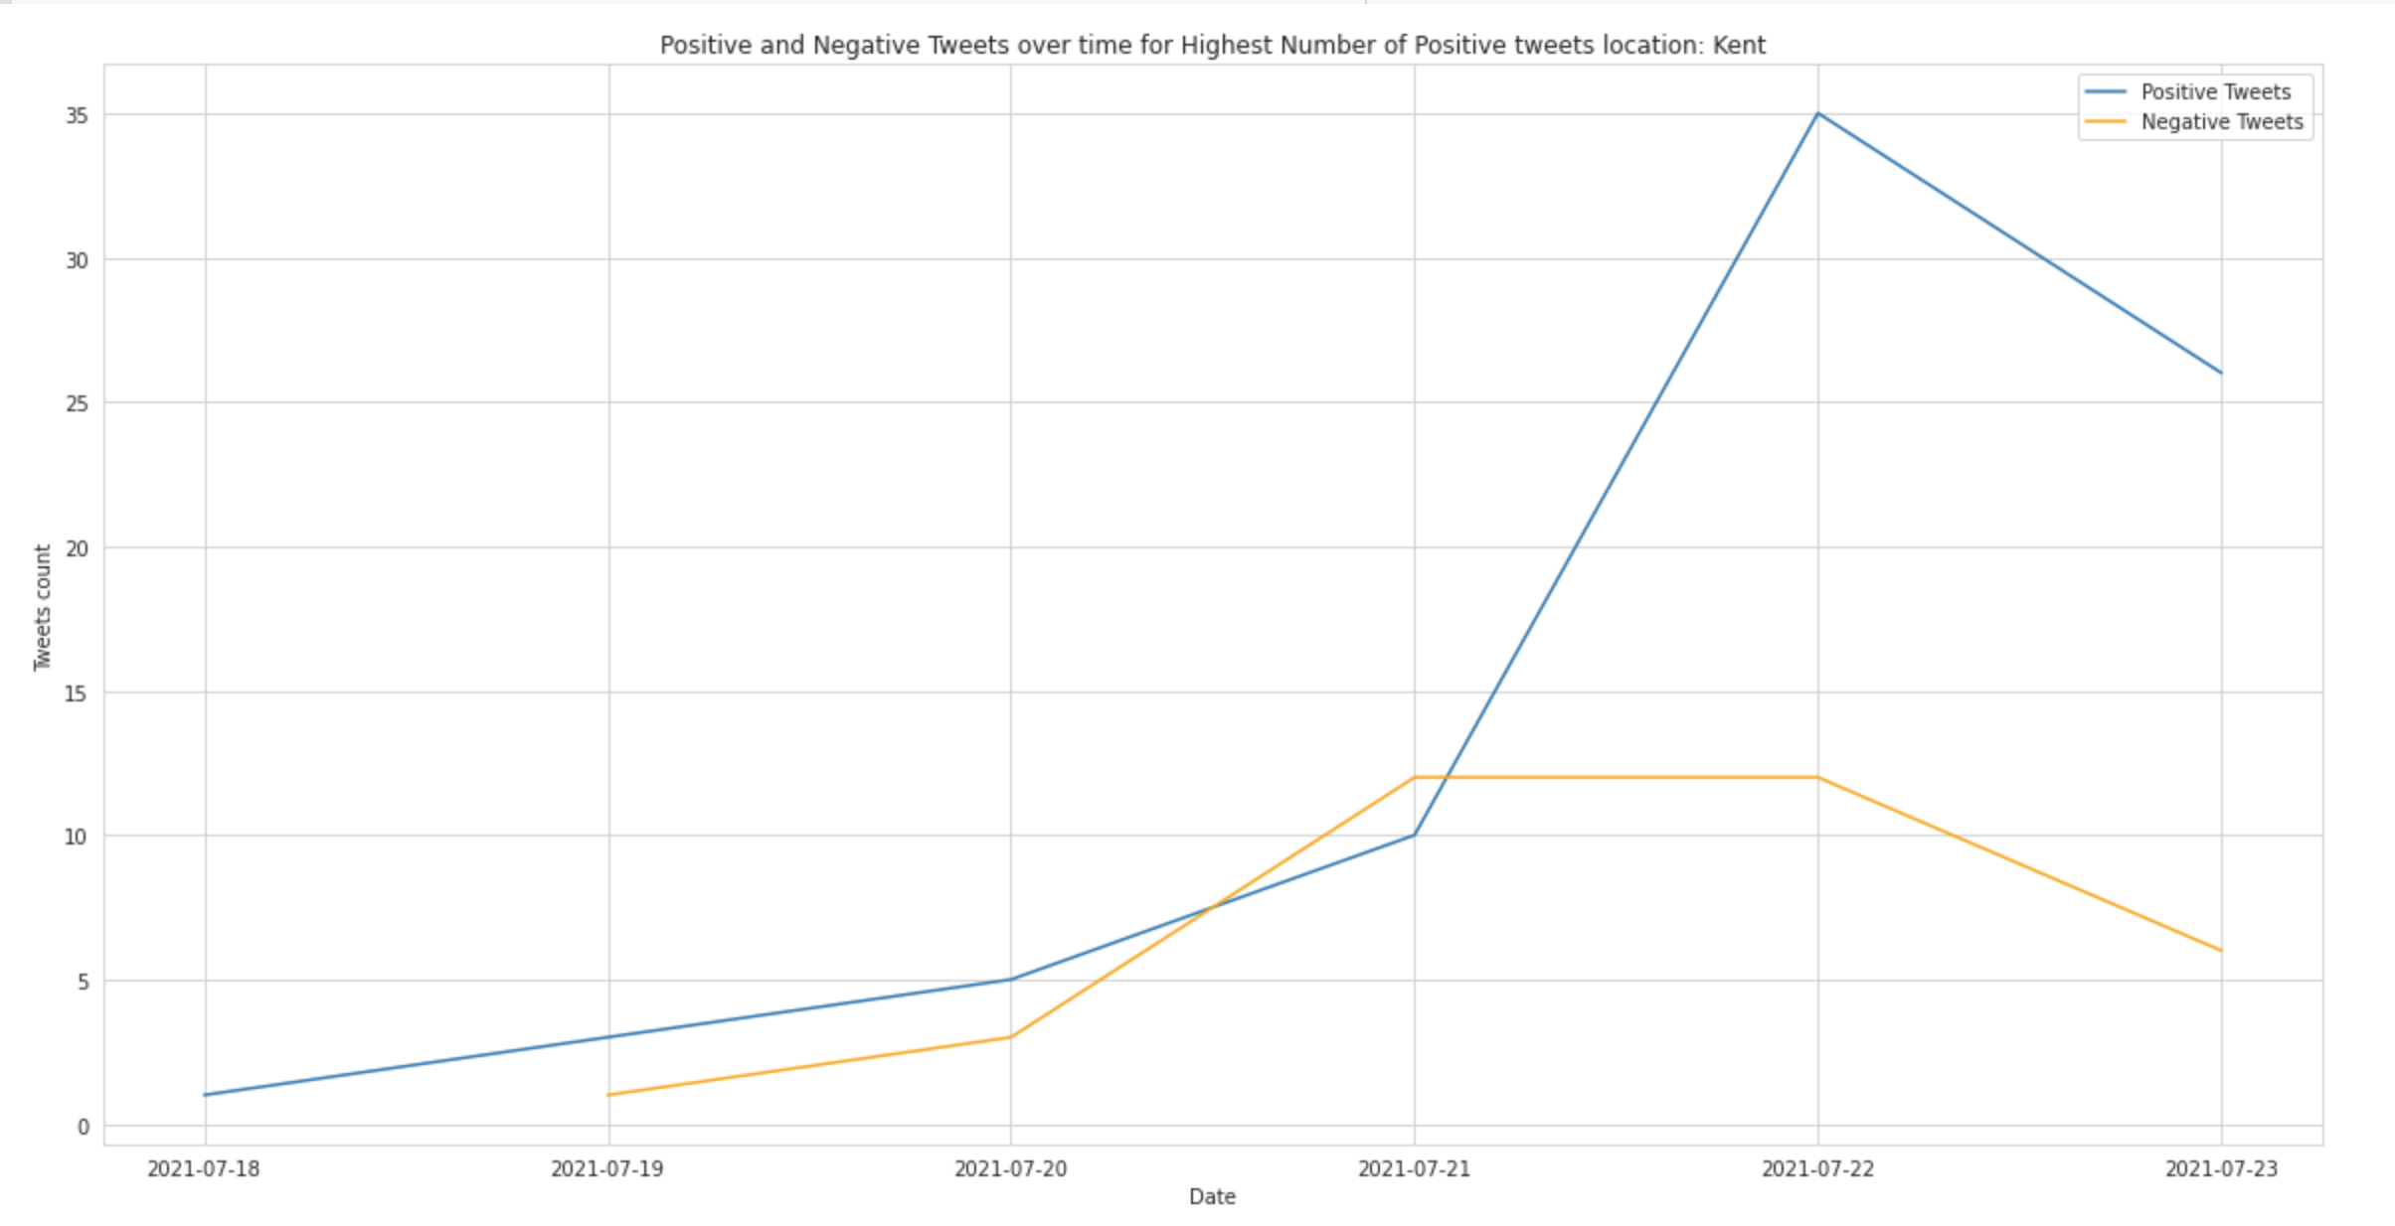
Sentiment Classification Results: SentiHood
Kent
Highest number of positive tweets
Spatio-Temporal Urban Sentiment Analysis
Optimizing and Recycling of PET and PE blends for Additive Manufacturing Applications using different mixing ratios

Slide 20
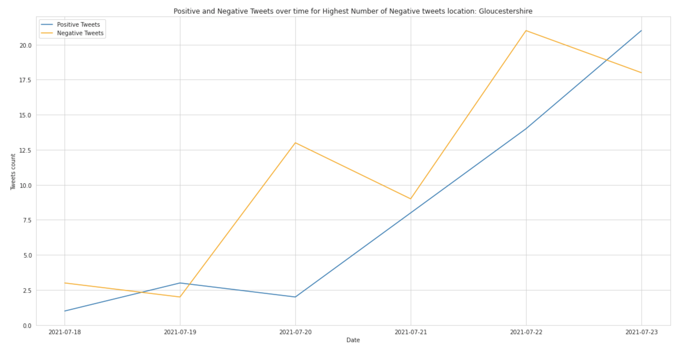
Sentiment Classification Results: SentiHood
Gloucestershire
Highest number of negative tweets
Spatio-Temporal Urban Sentiment Analysis
Optimizing and Recycling of PET and PE blends for Additive Manufacturing Applications using different mixing ratios

Slide 21
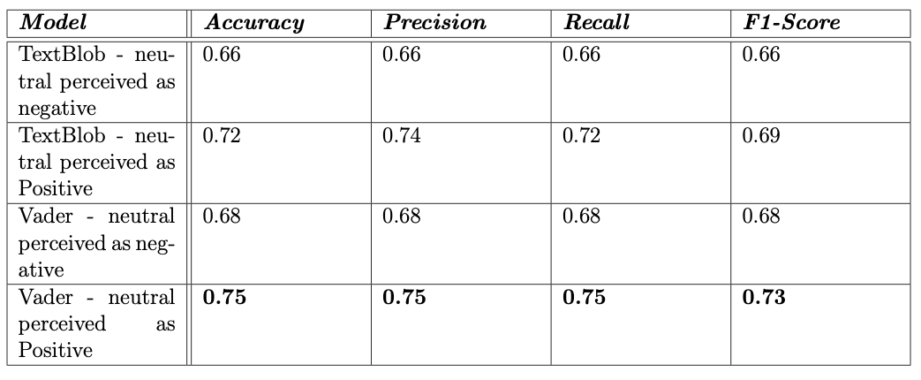
Sentiment Classification Results: Twitter Corpus
The highest accuracy (75%) was reached with VADER model where the neutral class was perceived as positive.
Spatio-Temporal Urban Sentiment Analysis
Optimizing and Recycling of PET and PE blends for Additive Manufacturing Applications using different mixing ratios

Slide 22
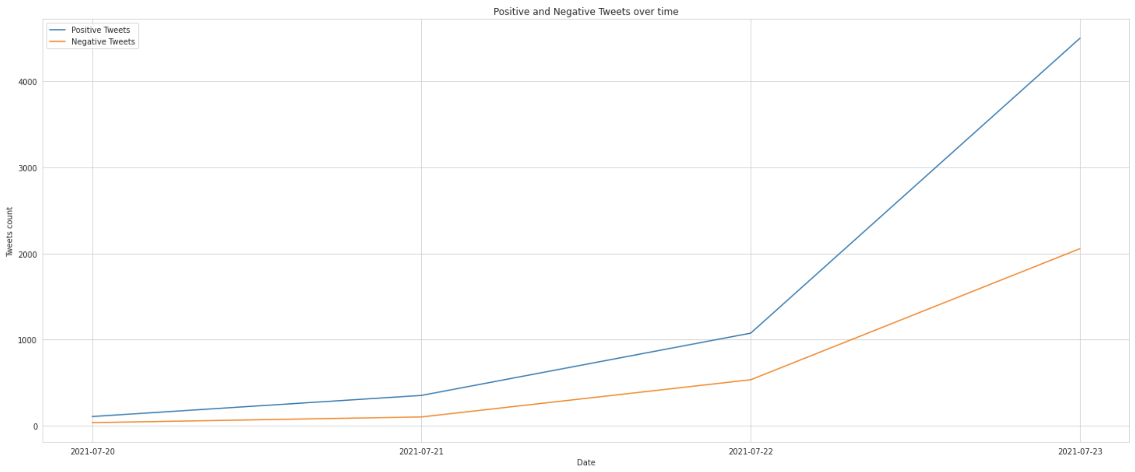
Sentiment Classification Results: Twitter Corpus
The positive sentiment was leading during the entire time.
Spatio-Temporal Urban Sentiment Analysis
Optimizing and Recycling of PET and PE blends for Additive Manufacturing Applications using different mixing ratios

Slide 23
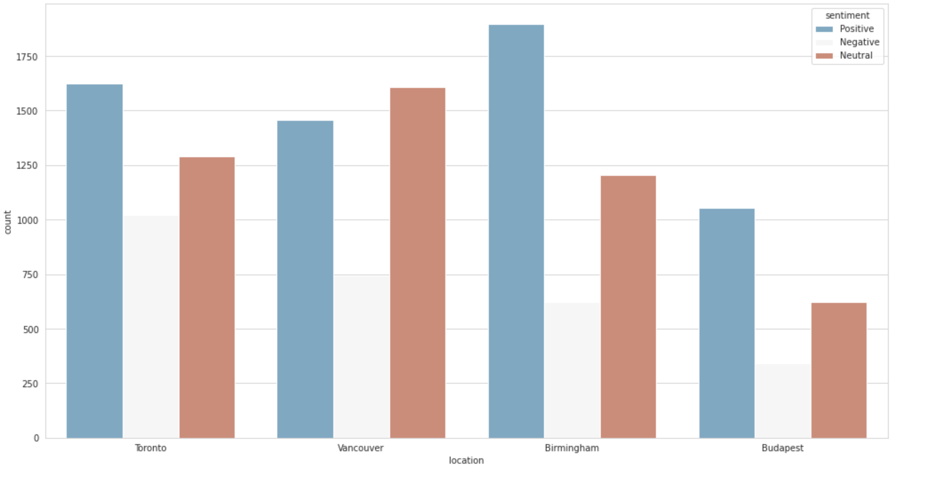
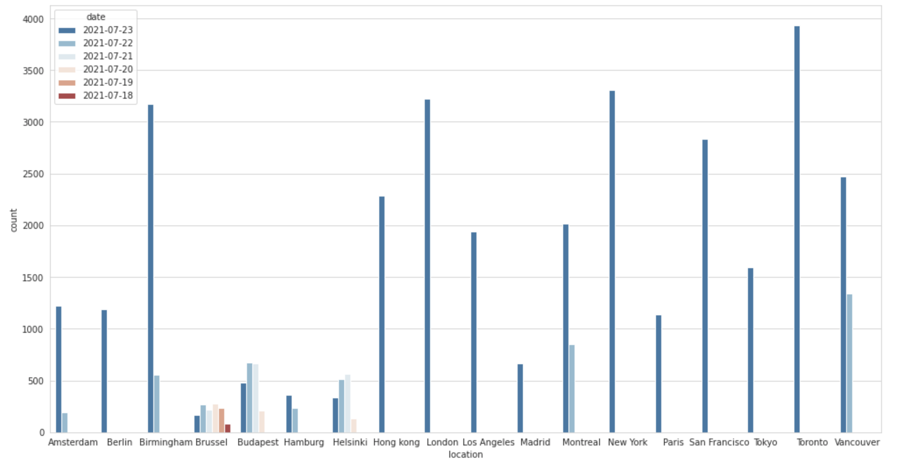
Sentiment Classification Results: Twitter Corpus
Instead of analyzing 18 cities, we analyzed:
Toronto
Vancouver
Birmingham
Budapest.

Slide 24
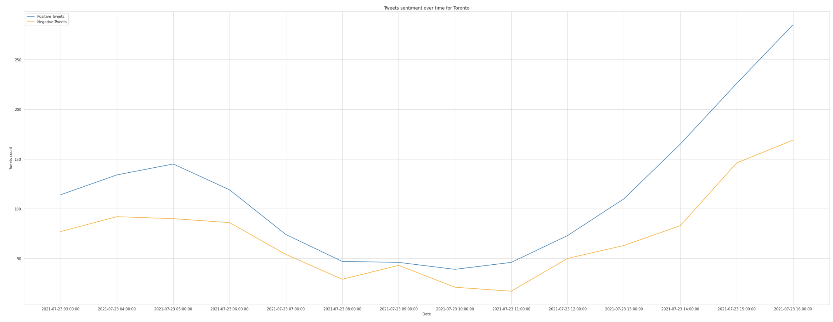
Sentiment Classification Results: Twitter Corpus
Toronto
Positive sentiment is leading at all times.
Music festivals taking place in Toronto and Vancouver results in higher engagement on twitter mostly starting around 10 pm
A football match in Toronto starting at 12 pm causes a spike in twitter activity.
Spatio-Temporal Urban Sentiment Analysis

Slide 25
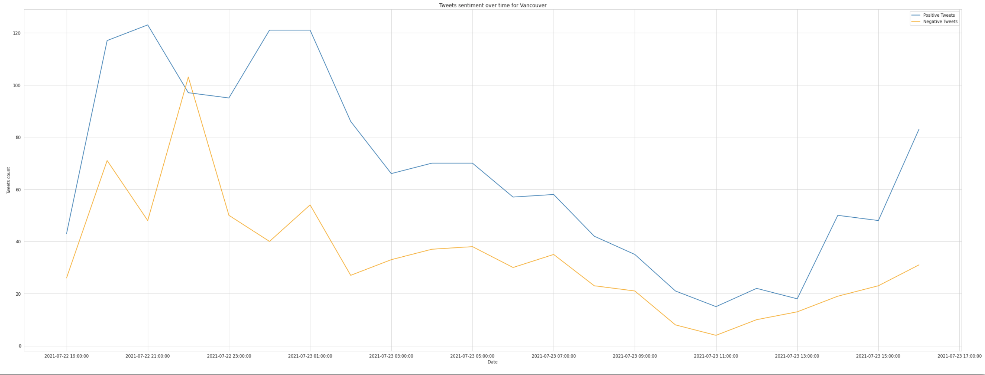
Sentiment Classification Results: Twitter Corpus
Vancouver
Music festivals taking place in Toronto and Vancouver results in higher engagement on twitter mostly starting around 10 pm
Activity dropped during morning hours.

Slide 26
Sentiment Classification Results: Twitter Corpus
Most tweets in Toronto and Vancouver were posted by students about the summer vacation with their families there.
Negative tweets showed safety concerns due to the brutality of the police force attacking homeless encampment, as well as concerns about the affordable-housing crisis

Slide 27
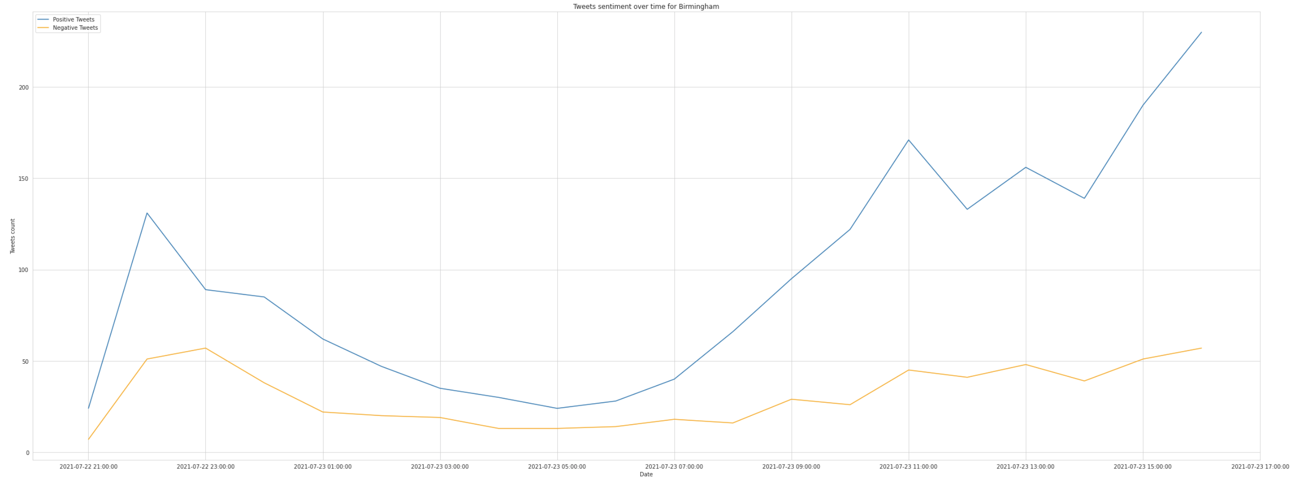
Sentiment Classification Results: Twitter Corpus
Birmingham
Birmingham tweets were stable most of the time.
Residents posted positive tweets in general about living there.
Negative tweets were related to covid-19 vaccines.
An unrelated spike occurred around 11pm due to a cricket match.
Spatio-Temporal Urban Sentiment Analysis
Optimizing and Recycling of PET and PE blends for Additive Manufacturing Applications using different mixing ratios

Slide 28
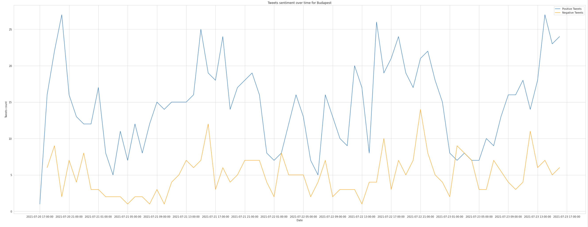
Sentiment Classification Results: Twitter Corpus
Budapest
Even though the tweets counts for both sentiments was fluctuating, the activity is natural where people are most active during the day (starting 1 pm, dropping at 9 pm) and most inactive at night (around 1 am)
Spatio-Temporal Urban Sentiment Analysis
Optimizing and Recycling of PET and PE blends for Additive Manufacturing Applications using different mixing ratios

Slide 29
Sentiment Classification Results: Twitter Corpus
Budapest tweets reflect residents and tourists opinions of the city, its hotels and touristic attractions.
Summer vacation trips to Europe taking place is the reason behind the high engagement rates.
Negative tweets were caused by protests against anti-gay laws.
Spatio-Temporal Urban Sentiment Analysis
Optimizing and Recycling of PET and PE blends for Additive Manufacturing Applications using different mixing ratios

Slide 30
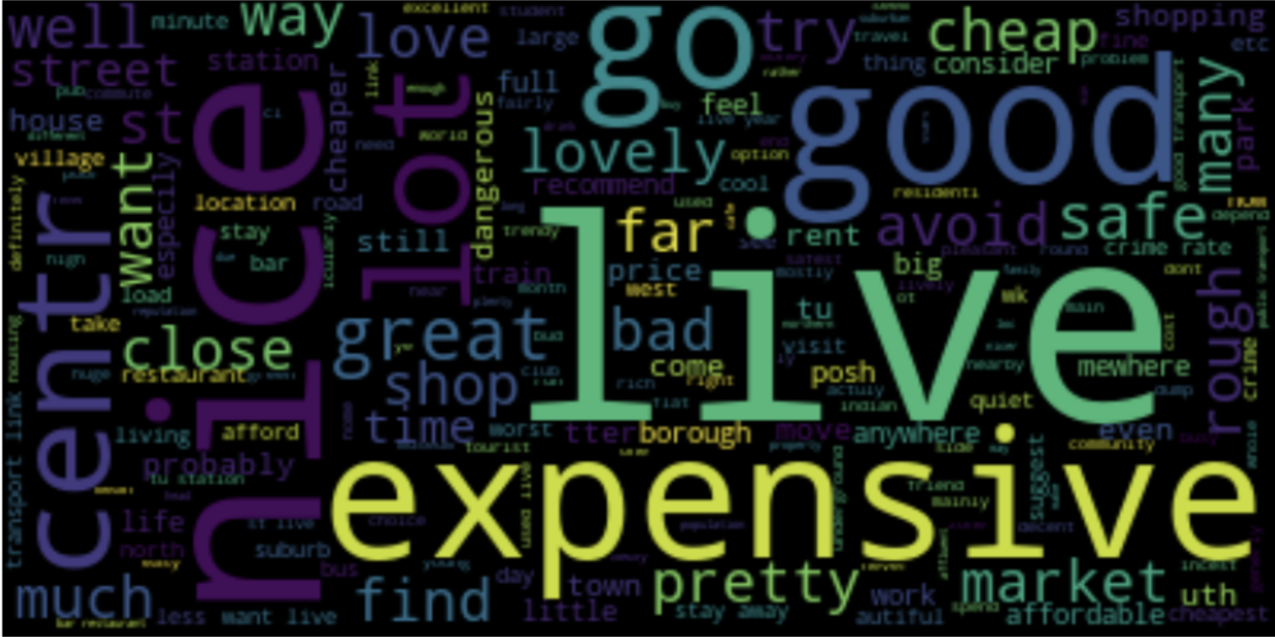
Conclusion: SentiHood
A direct relation between the location and the sentiment was captured while analyzing SentiHood dataset.
For the most part residents in England were satisfied with their towns but irritated with the prices.
The main limitations were the size of the dataset and the lack of time information.
Spatio-Temporal Urban Sentiment Analysis

Slide 31
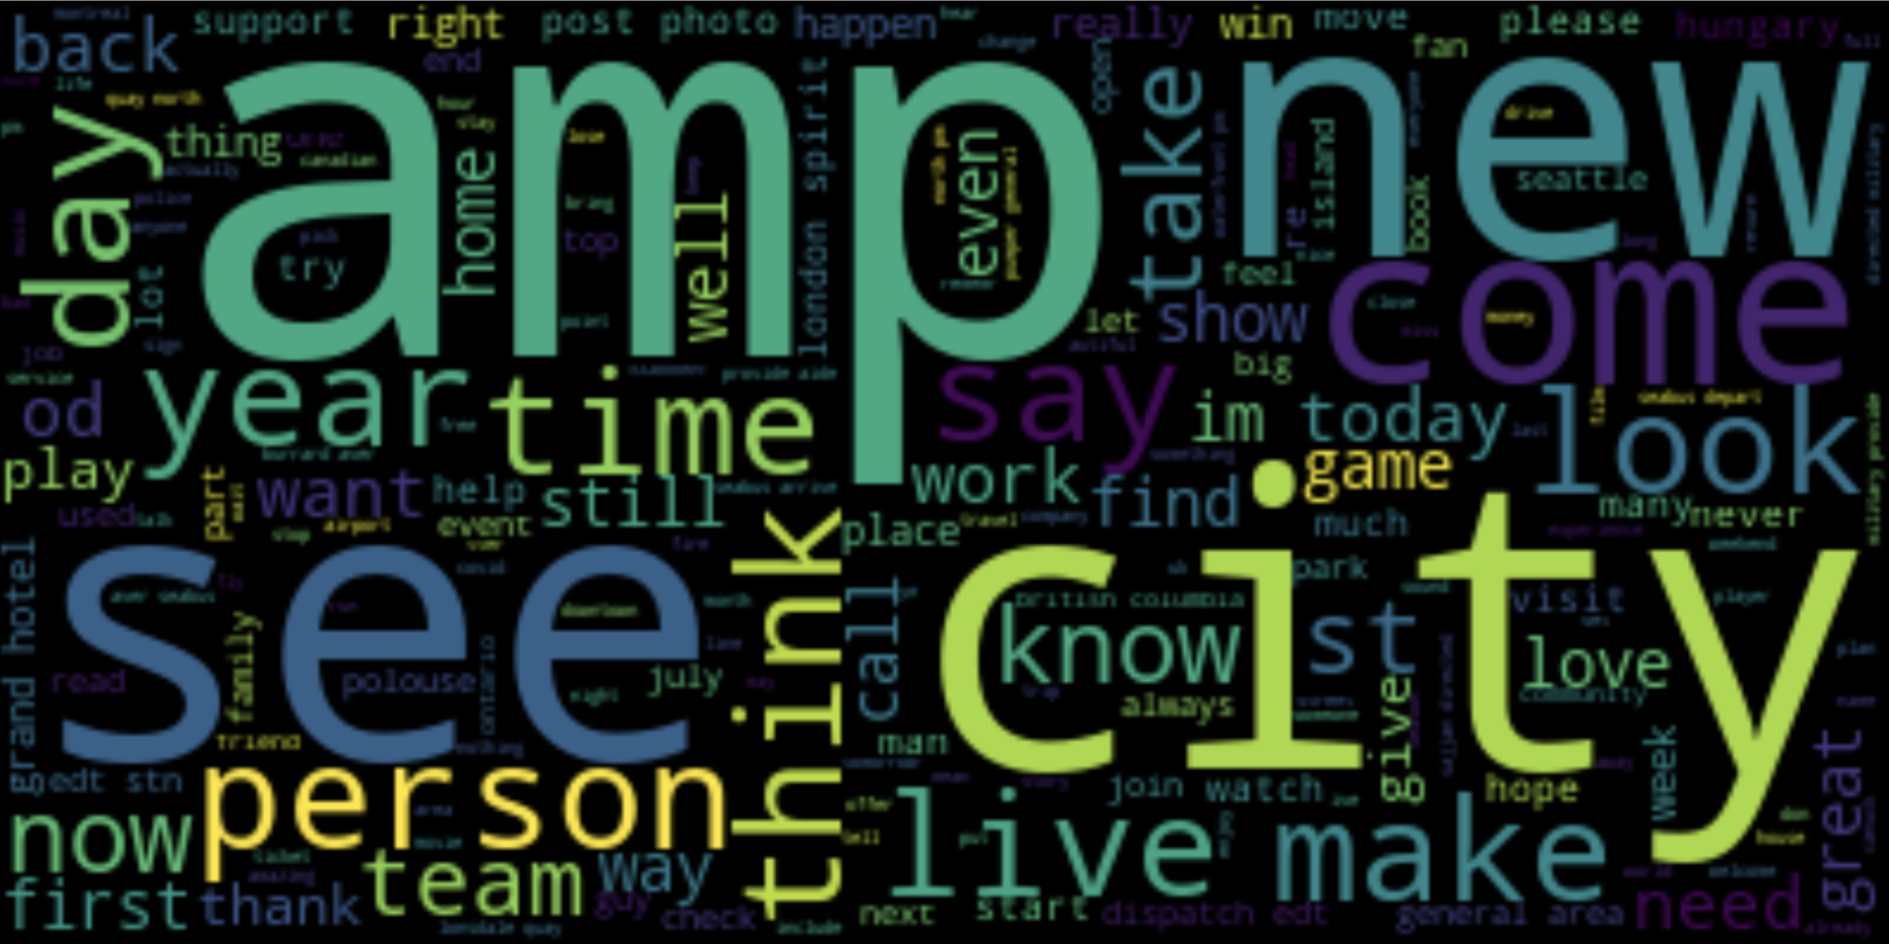
Conclusion: Twitter Corpus
A direct relation between the location, the time and the sentiment was captured while analyzing the twitter corpus.
Residents were mainly interested in activities in the city, due to the summer vacation.
The main limitation for this dataset was not handling emoticon or sarcasm.
Spatio-Temporal Urban Sentiment Analysis

Slide 32
Conclusion
General limitations of the research:
Analyzing only English tweets.
Twitter is more popular among the younger generations.
Spatio-Temporal Urban Sentiment Analysis

Slide 33
Future Work
Conducting this study on Egyptian neighborhoods, analyzing arabic tweets.
Exploring better sentiment classification approaches for higher accuracy.
Conduct the research on real time audio data.
Spatio-Temporal Urban Sentiment Analysis

Slide 34
Thank you
Spatio-Temporal Urban Sentiment Analysis

